Slide 1



Chemostat with Two Yeast Populations
Continuous Models Qualitative Analysis
Outline
1
Two Populations Experiments
2
Continuous Models Malthusian Growth Model Logistic Growth Model
Logistic Growth Model Solution
3
Qualitative Analysis Equilibria and Linearization Direction Field
Phase Portrait

Slide 2
Chemostat with Two Yeast Populations
Continuous Models Qualitative Analysis
Introduction
Introduction
Studied discrete dynamical population models
Have the potential to have chaotic dynamics Closed form solutions are very limited Qualitative analysis gave limited results
Extend models to continuous domain – ODEs Differential equations often easier to analyze
Allows examining populations without discrete sampling Qualitative analysis shows solutions are better behaved
Begin examining two yeast species competing for a limited resource (nutrient)

Slide 3
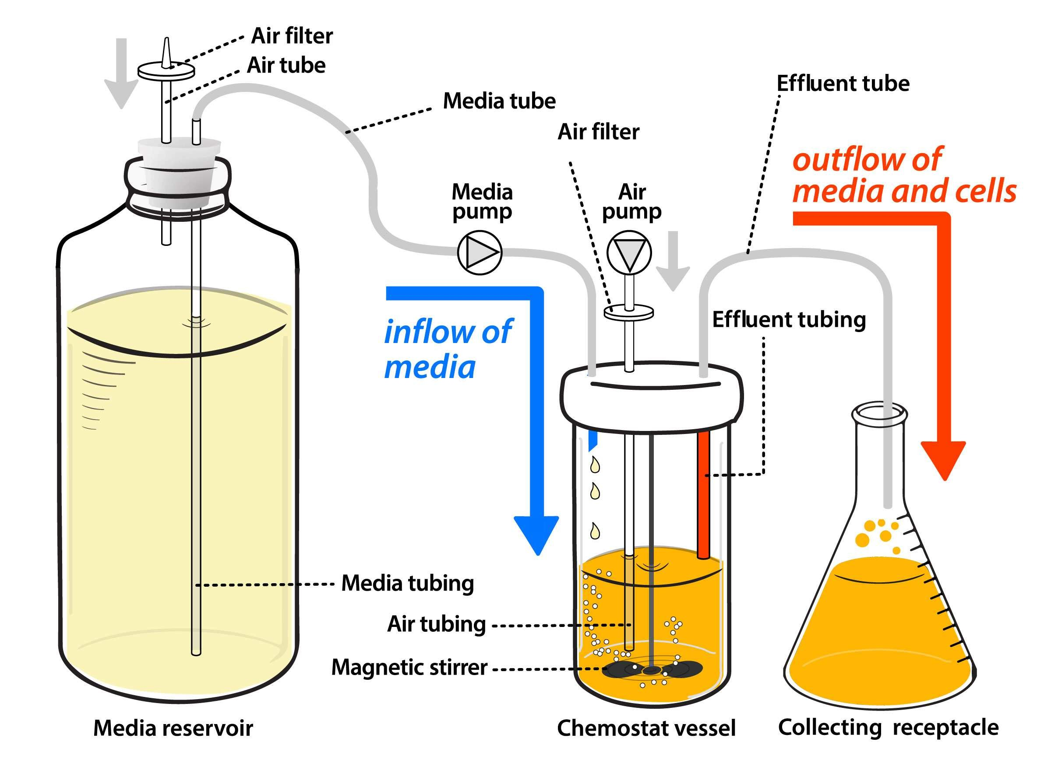
Chemostat with Two Yeast Populations
Continuous Models Qualitative Analysis
Gause Experiments
Diagram of Chemostat

Slide 4
Chemostat with Two Yeast Populations
Continuous Models Qualitative Analysis
Gause Experiments
Monoculture Yeast Experiments
Monoculture Yeast Experiments
Single species culture for Saccharomyces cerevisiae
Time (hr) | Volume | Time (hr) | Volume | Time (hr) | Volume
0 | 0.37 | 18 | 10.97 | 38 | 12.77
1.5 | 1.63 | 23 | 12.5 | 42 | 12.87
9 | 6.2 | 25.5 | 12.6 | 45.5 | 12.9
10 | 8.87 | 27 | 12.9 | 47 | 12.7
18 | 10.66 | 34 | 13.27
Single species culture for Schizosaccharomyces kephir
Time (hr) | Volume | Time (hr) | Volume | Time (hr) | Volume
9 | 1.27 | 42 | 2.73 | 87 | 5.67
10 | 1 | 45.5 | 4.56 | 111 | 5.8
23 | 1.7 | 66 | 4.87 | 135 | 5.83
25.5 | 2.33
The much slower growing Schizosaccharomyces kephir required much longer to approach the carrying capacity.

Slide 5
Chemostat with Two Yeast Populations
Continuous Models Qualitative Analysis
Gause Experiments
Mixed Culture Yeast Experiments
Mixed Culture Yeast Experiments
This experiment examines the competition of 2 yeast species competing for the same resource.
Time (hr) | 0 | 1.5 | 9 | 10 | 18 | 18 | 23
Vol (S. cerevisiae) | 0.375 | 0.92 | 3.08 | 3.99 | 4.69 | 5.78 | 6.15
Vol (S. kephir ) | 0.29 | 0.37 | 0.63 | 0.98 | 1.47 | 1.22 | 1.46
Time (hr) | 25.5 | 27 | 38 | 42 | 45.5 | 47
Vol (S. cerevisiae) | 9.91 | 9.47 | 10.57 | 7.27 | 9.88 | 8.3
Vol (S. kephir ) | 1.11 | 1.225 | 1.1 | 1.71 | 0.96 | 1.84
The data show the populations increasing, but do these populations move toward an equilibrium or does something else happen with the populations?
What techniques do we have to fit models to the data?

Slide 6
Chemostat with Two Yeast Populations
Continuous Models Qualitative Analysis
Malthusian Growth Model Logistic Growth Model
Logistic Growth Model Solution
Malthusian Growth Model
Malthusian Growth Model: The discrete Malthusian growth model has the form:
P_{n+1} = (1 + r)P_{n},
where P_{n} is the population at time n and r is the per capita growth rate.
We want change this model into a continuous model.
Let P_{n} ≡ P (t) and assume a time step of ∆t, so P_{n+1} ≡ P (t + ∆t). Assume that r is the per capita growth rate per unit time, then the
discrete model becomes:
P (t + ∆t) = (1 + r∆t)P (t).
This can be rearrranged to give
P (t + ∆t) − P (t) _{= rP (t).}
P (t + ∆t) − P (t) = r∆tP (t) or
∆t

Slide 7
Chemostat with Two Yeast Populations
Continuous Models Qualitative Analysis
Malthusian Growth Model Logistic Growth Model
Logistic Growth Model Solution
Continuous Growth Model
Continuous Growth Model: The discrete Malthusian growth model was rearranged to give:
P (t + ∆t) − P (t) = r∆tP (t), so consider the limiting case as ∆t → 0,
P (t + ∆t) − P (t)
lim = rP (t).
∆t→0
∆t
The left hand side is the definition of the derivative, so this equation becomes:
dP
= rP (t), P (0) = P₀,
dt
which is the continuous Malthusian growth model. This is a first order linear differential equation.

Slide 8
Chemostat with Two Yeast Populations
Continuous Models Qualitative Analysis
Malthusian Growth Model Logistic Growth Model
Logistic Growth Model Solution
Malthusian Growth Model
Malthusian Growth Model: The continuous Malthusian growth model:
dP
= rP (t), P (0) = P₀,
dt
has the solution:
P (t) = P₀e^{rt}.
The early stages of the yeast cultures both show this exponential growth.
How might we match this model to the first 10 hours (4 data points) of the growing culture of Saccharomyces cerevisiae?
There are multiple methods for fitting this model to these data.

Slide 9
Chemostat with Two Yeast Populations
Continuous Models Qualitative Analysis
Malthusian Growth Model Logistic Growth Model
Logistic Growth Model Solution
Fitting the Malthusian Growth Model 1
The Malthusian growth model is given by:
P (t) = P₀e^{rt},
and we want to fit the data (t_{i}, P_{i}):
(0, 0.37), (1.5, 1.63), (9, 6.2), and (10, 8.87).
If we are simply fitting these data to obtain an estimate on the value of r, then an algebraic fit through the first and third points is sufficient with P₀ = 0.37 and
P (9) = 0.37e^{9r} = 6.2 or r = ln(16.76)/9 = 0.3132,
which gives:
P (t) = 0.37e^{0.3132t}.

Slide 10
Chemostat with Two Yeast Populations
Continuous Models Qualitative Analysis
Malthusian Growth Model Logistic Growth Model
Logistic Growth Model Solution
Fitting the Malthusian Growth Model 2
The Malthusian growth model, P (t) = P₀e^{rt}, is fit through the data (t_{i}, P_{i}): (0, 0.37), (1.5, 1.63), (9, 6.2), and (10, 8.87).
Frequently, exponential models are fit with the linear least squares best fit to the logarithm of data:
ln(P (t)) = ln(P₀) + rt,
which has slope, r, and intercept, ln(P₀).
The linear least squares best fit to the logarithm of data gives the equation:
ln(P (t)) = 0.2690 t − 0.5034,
which gives the best continuous Malthusian growth model,
P (t) = 0.6045 e^{0.2690 t}.

Slide 11
Chemostat with Two Yeast Populations
Continuous Models Qualitative Analysis
Malthusian Growth Model Logistic Growth Model
Logistic Growth Model Solution
Fitting the Malthusian Growth Model 3
Alternately, the Malthusian growth model, P (t) = P₀e^{rt}, is fit through the data (t_{i}, P_{i}): (0, 0.37), (1.5, 1.63), (9, 6.2), and (10, 8.87), using a nonlinear least squares best fit to the data.
The nonlinear least squares best fit to the data gives the best continuous Malthusian growth model,
P (t) = 0.6949 e^{0.2511 t}.
1 function J = yst lstm(p, tdata, pdata)
2 % Least Squares fit to Logistic Growth
3 N = length(tdata);
4 yst = p(1)*exp(p(2)*tdata);
5 err = pdata - yst;
6 J = err*err'; % Sum of square errors
7 end

Slide 12
Chemostat with Two Yeast Populations
Continuous Models Qualitative Analysis
Malthusian Growth Model Logistic Growth Model
Logistic Growth Model Solution
Fitting the Malthusian Growth Model 4
15
Yeast Data Exponential Model Nonlinear Fit
10
5
0
0
5
10
15
20
25
30

Slide 13
Chemostat with Two Yeast Populations
Continuous Models Qualitative Analysis
Malthusian Growth Model Logistic Growth Model
Logistic Growth Model Solution
Logistic Growth Model
1
These models fit the initial data reasonably well, but are inadequate for describing the complete set of data.
The data show a leveling off of the populations, so different models are required.
The experiments supply a fixed amount of nutrient, so maximum population is limited.
The Malthusian growth model simulates the early exponential growth of populations, but suppression of growth later in time is required to fit the data.
The two data sets, S. cerevisiae and S. kephir, show significantly different growth rates and carrying capacity.

Slide 14
Chemostat with Two Yeast Populations
Continuous Models Qualitative Analysis
Malthusian Growth Model Logistic Growth Model
Logistic Growth Model Solution
Logistic Growth Model
2
The general continuous growth model satisfies the differential equation:
dP
= f (t, P (t)).
dt
However, yeast populations should not depend on time, so the appropriate model is:
dP
= f (P (t)).
dt
The Malthusian growth model is:
dP dt
= rP (t),
which has f (P ) = rP , a linear function of P , giving the exponential growth for a solution.

Slide 15
Chemostat with Two Yeast Populations
Continuous Models Qualitative Analysis
Malthusian Growth Model Logistic Growth Model
Logistic Growth Model Solution
Logistic Growth Model
3
The Maclaurin series expansion of f (P ) is
f ′′(0)
f (P ) = f (0) + f ′(0)P +
P ² + O P ³ ,
2!
3 3
where O P means order P .
The yeast (chemostat) problem is a closed system, so when the population is at extinction or 0, which implies:
f (0) = 0.
The linear term comes from the Malthusian growth, so
f ′(0) = r.

Slide 16
Chemostat with Two Yeast Populations
Continuous Models Qualitative Analysis
Malthusian Growth Model Logistic Growth Model
Logistic Growth Model Solution
Logistic Growth Model
4
The population growth rate declines for larger populations, so we expect the next term in the series expansion must be negative.
In biology, this is known as intraspecies competition. Mathematically, this implies:
f ′′(0) r
= −_{M} ,
2!
where r is from the Malthusian growth and as we’ll see later M is the
carrying capacity.
Ignoring the higher order terms of f (p) gives the logistic growth
model:
dP
= rP 1 − ,
P
P (0) = P .
dt
M
0

Slide 17
Chemostat with Two Yeast Populations
Continuous Models Qualitative Analysis
Malthusian Growth Model Logistic Growth Model
Logistic Growth Model Solution
Logistic Growth Model Solution
1
The logistic growth model:
dP
= rP 1 − ,
P
P (0) = P ,
dt M
0
can be solved using separation of variables. Alternately, we can use Bernoulli’s method. Consider
dP rP ²
_{dt} − rP = − _{M} , and let
−1
u = P ,
du
−2 dP
then = −P .
dt dt
If we multiply the equation above by −P⁻², then
dP r
dt
du r
so + ru = . dt M
−P
−2
−1
+ rP = ,
M
The u equation is rewritten:
d dt
_{re}rt
rt
e u = .
M

Slide 18
Chemostat with Two Yeast Populations
Continuous Models Qualitative Analysis
Malthusian Growth Model Logistic Growth Model
Logistic Growth Model Solution
Logistic Growth Model Solution
2
The u equation is solved by integration, so :
_{re}rt M
d dt
1
1
rt
−rt
e u =
gives u(t) = + ce = .
M
P (t)
The initial condition gives:
1 1 M − P
0
c = − =
.
P₀ M MP₀
When the initial condition is inserted, a little algebra yields:
MP₀
P (t) = .
P₀ + (M − P₀)e^{−rt}

Slide 19
Chemostat with Two Yeast Populations
Continuous Models Qualitative Analysis
Malthusian Growth Model Logistic Growth Model
Logistic Growth Model Solution
Logistic Growth Model Solution
3
The exact functional form of the solution:
MP₀
P (t) = ,
P₀ + (M − P₀)e^{−rt}
has 3 parameters and can be readily fit to the Gause data. The sum of square errors formula for fitting data, P_{d}(t_{i}), is:
Σ
N
MP
2
J(P₀, r, M ) = P_{d}(t_{i}) −
0
,
P₀ + (M − P₀)e^{−rti}
i=0
which we minimize in Matlab with fminsearch.
An initial guess for the parameters p₀ = [P₀, r, M ] would be to take P₀ = P_{d}(t₀), r equal the value from the Malthusian growth model, and M = P_{d}(t_{N} ).

Slide 20
Chemostat with Two Yeast Populations
Continuous Models Qualitative Analysis
Malthusian Growth Model Logistic Growth Model
Logistic Growth Model Solution
Logistic Growth Model Solution
4
The sum of square errors code, which is used to find the best parameter fit, is:
1 function J = yst lst(p, tdata, pdata)
2 % Least Squares fit to Logistic Growth
3 N = length(tdata);
4 yst = p(1)*p(2)./(p(1) + ...
(p(2)-p(1))*exp(-p(3)*tdata));
5 err = pdata - yst;
6 J = err*err'; % Sum of square errors
7 end
The best fitting parameters come from executing fminsearch: p1 = fminsearch(@yst lst,p0,[],tdata,pdata)

Slide 21
Chemostat with Two Yeast Populations
Continuous Models Qualitative Analysis
Malthusian Growth Model Logistic Growth Model
Logistic Growth Model Solution
Logistic Growth Model Solution
4
The best fitting parameters for Saccharomyces cerevisiae and
Schizosaccharomyces kephir are given by:
P₀ = 1.2343, r = 0.25864, M = 12.7421,
and
P₀ = 0.67807, r = 0.057442, M = 5.8802
with least SSE = 4.9460 and SSE = 1.3850, respectively. This produces the best fitting solutions:
12.742 5.880
P (t) =
and P (t) =
.
_{1 + 9.323 e}−0.2586t _{1 + 7.672 e}−0.05744t

Slide 22
Chemostat with Two Yeast Populations
Continuous Models Qualitative Analysis
Malthusian Growth Model Logistic Growth Model
Logistic Growth Model Solution
Logistic Growth Model Solution
5
The graphs of the data with the best fitting models are shown below.
Saccharomyces cerevisiae
6
5
4
3
2
1
0
Schizosaccharomyces kephir
15
P (t) (Volume)
10
P (t) (Volume)
5
0
0
10
20
30
40
50
0
50
100
150
t (hrs)
t (hrs)

Slide 23
Chemostat with Two Yeast Populations
Continuous Models Qualitative Analysis
Equilibria and Linearization Direction Field
Phase Portrait
Equilibria
1
Qualitative Analysis of continuous models provides information about types of possible behaviors of the models, such as
dP dt
= f (P ).
It is important to learn the local behavior of the continuous dynamical model near its Equilibria.
Like discrete dynamical models, the analysis of continuous models with differential equations begins with finding Equilibria.
Equilibria of differential equations are found by setting the
derivative equal to 0 or
f (P_{e}) = 0,
which for population models means no growth.

Slide 24
Chemostat with Two Yeast Populations
Continuous Models Qualitative Analysis
Equilibria and Linearization Direction Field
Phase Portrait
Equilibria
2
For the logistic growth model,
dP
= rP 1 − ,
P
dt
M
the equilibria satisfy:
P
e
rP 1 −
= 0 or P = 0 or M.
e
M
e
Like the discrete model, the logistic growth model has the extinction or trivial equilibrium, P_{e} = 0, and the carrying capacity equilibrium, P_{e} = M .
We expect that locally solutions “near” the extinction equilibrium should move away and be unstable, while solutions “near” the carrying capacity equilibrium should approach and be stable.

Slide 25
Chemostat with Two Yeast Populations
Continuous Models Qualitative Analysis
Equilibria and Linearization Direction Field
Phase Portrait
Linearization
1
The local behavior of the continuous dynamical model near its
equilibria depends on the linear terms of the function f .
Since f (P_{e}) = 0, the Taylor series expansion is:
f (P ) = f ′(P_{e})(P − P_{e}) + O (P − P_{e})² .
If f ′(P_{e}) > 0, then locally the solution grows exponentially (positive eigenvalue) and the equilibrium at P_{e} is unstable.
If f ′(P_{e}) < 0, then locally the solution decays exponentially (negative eigenvalue) and the equilibrium at P_{e} is stable.
If f ′(P_{e}) = 0, then more information must be obtained to determine the stability of the equilibrium at P_{e}.

Slide 26
Chemostat with Two Yeast Populations
Continuous Models Qualitative Analysis
Equilibria and Linearization Direction Field
Phase Portrait
Linearization
2
Stability of Logistic Growth Model: The equilibria are P_{e} = 0 and M .
The function and its derivative satisfy:
P 2rP
f (P ) = rP 1 − ,
′
so f (P ) = r − ,
M M
where r > 0 is the Malthusian growth rate at low density and M is the carrying capacity.
At the extinction equilibrium, P_{e} = 0, we have f ′(0) = r, which is positive and makes this equilibrium unstable.
At the carrying capacity equilibrium, P_{e} = M , we have
f ′(M ) = −r, which is negative and makes this equilibrium stable.
These results suggest that differential equation governing the logistic growth model has an initial exponential growth before moving smoothly toward the carrying capacity.

Slide 27
Chemostat with Two Yeast Populations
Continuous Models Qualitative Analysis
Equilibria and Linearization Direction Field
Phase Portrait
Direction Field
1
Consider the general differential equation with initial value:
dy
= f (t, y), y(t₀) = y₀.
dt
The function f (t, y) provides the slope of the solution.
The slope of the solution is easily found by computer programs on a grid, so the program can generate arrows showing the direction of the solution.
The direction field is this graphical representation in the y vs. t
plane with arrows showing the direction of the solution.

Slide 28
Chemostat with Two Yeast Populations
Continuous Models Qualitative Analysis
Equilibria and Linearization Direction Field
Phase Portrait
Maple Simulation
We demonstrate the use of Maple for examining the logistic growth model for Saccharomyces cerevisiae.
Enter the differential equation for the model:
> de := diff (P (t), t) = 0.2586 · P (t) · 1 −
P (t) 12.742
;
This equation is solved with the following:
> dsolve({de, P (0) = 1.234}, P (t));
Maple can plot the direction field with any number of solutions using its package DEtools as shown below:
> with(DEtools) :
> DEplot(de, P (t), t = 0..30, [[P (0) = .2], [P (0) = 1.234], [P (0) =
2], [P (0) = 5], [P (0) = 9], [P (0) = 12], [P (0) = 16]], P = 0..16, colour =
blue, linecolour = t, title = LogisticGrowthModel);
(Plot appears on the next slide.)

Slide 29
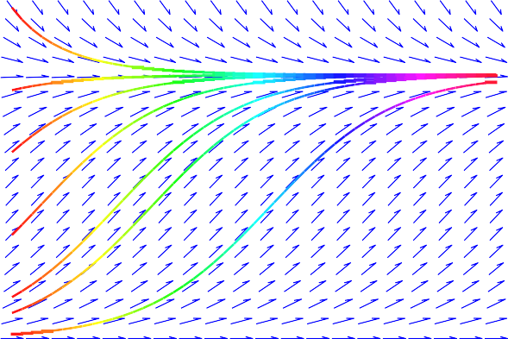
Chemostat with Two Yeast Populations
Continuous Models Qualitative Analysis
Equilibria and Linearization Direction Field
Phase Portrait
Maple Direction Field Plot
From the previous slide, Maple produces the following plot:

Slide 30
Chemostat with Two Yeast Populations
Continuous Models Qualitative Analysis
Equilibria and Linearization Direction Field
Phase Portrait
Existence and Uniqueness
The differential equation:
y ′ = f (t, y), with y(t₀) = y₀, (1) with reasonable conditions on f has the existence and uniqueness
of its solutions.
Theorem
If f and ∂f/∂y are continuous in a rectangle
R : |t − t₀| ≤ a, |y − y₀| ≤ b, then there is some interval
|t − t₀| ≤ h ≤ |a| in which there exists a unique solution y = φ(t) of the initial value problem (1).
This theorem guarantees that solutions don’t cross on a graph.
Thus, geometrically it is easy to trace the direction of the solution from any starting point in the direction field.

Slide 31
Chemostat with Two Yeast Populations
Continuous Models Qualitative Analysis
Equilibria and Linearization Direction Field
Phase Portrait
AutonomousDirection Field
We examine the direction field of the autonomous differential equation
dy
= f (y).
dt
In the y vs. t-plane, the direction field is constant for each value of
y.
Equilibria, y_{e}, have slope 0 in the direction field.
Between equilibria, the direction field has only slopes with the same sign.
It follows that solutions monotonically go toward or away from
equilibria.
The qualitative behavior of the autonomous differential equation is captured in a 1D-line, where equilibria are marked and solution directions are noted with arrows pointing right or left.
Continuous Models Logistic and Malthusian G
— (35/37)

Slide 32
Chemostat with Two Yeast Populations
Continuous Models Qualitative Analysis
Equilibria and Linearization Direction Field
Phase Portrait
Phase Portrait
1
The qualitative dynamics of a scalar autonomous differential equation is given by a 1D-phase portrait.
For ^{dy} = f (y), graph f (y)
dt
Equilibria occur when f (y) = 0.
Solutions increase when f (y) > 0 and decrease when
f (y) < 0.
When arrows of the phase portrait point toward an equilibrium, then it is stable and is indicated with a solid circle.
When arrows of the phase portrait point away from an equilibrium, then it is unstable and is indicated with an open circle.
When arrows of the phase portrait go in the same direction through an equilibrium, then it is semi-stable and is indicated with a half open circle.

Slide 33
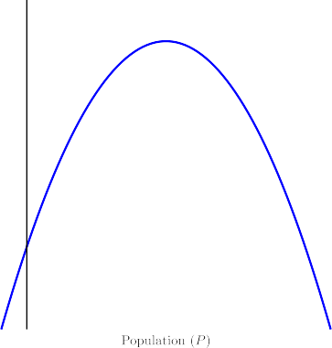
Chemostat with Two Yeast Populations
Continuous Models Qualitative Analysis
Equilibria and Linearization Direction Field
Phase Portrait
Phase Portrait
3
Logistic growth model
Horizontal axis is the
Phase Portrait.
Extinction equilibrium,
P_{e} = 0 ,
is unstable.
Carrying capacity,
P_{e} = M ,
is a stable equilibrium.
Positive initial conditions result in all solutions tending in time to the carrying capacity.
< > > > >
<

